Slide 1
Air Traffic Optimization
ISE 3230
Jiajun Chen
Carter Glazer
Satvik Kannekanti

Slide 2

Our Motivation
Our motivation to develop an MILP model to optimize flight routing stemmed from Jiajun, an international student, and Carter, from Los Angeles, who often faced flight delays and noticed inefficiencies in air traffic management.

Slide 3

Goal
What is our objective?
Minimize the total distance flown in the daily flight routing for 4 planes starting and ending at LAX, while ensuring:
Each plane completes either 4 or 5 flights daily
All planes must return to LAX by the end of the day
Each of the 13 other airports must be visited exactly once per day

Slide 4
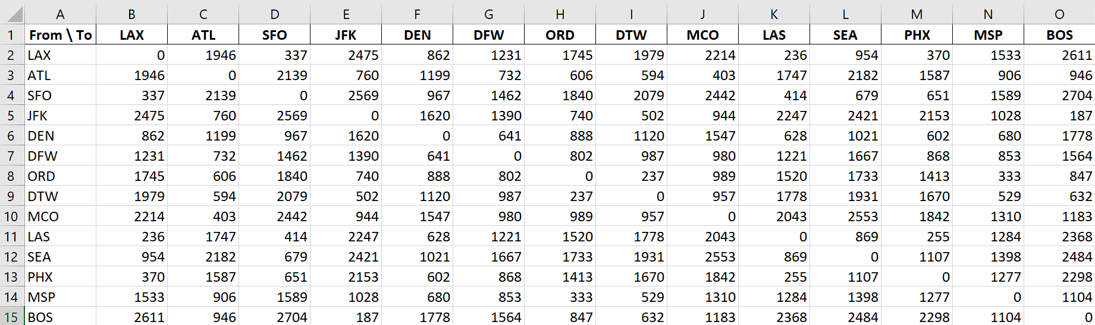
Data
What data are we using?
Source: https://www.airmilescalculator.com/

Slide 5
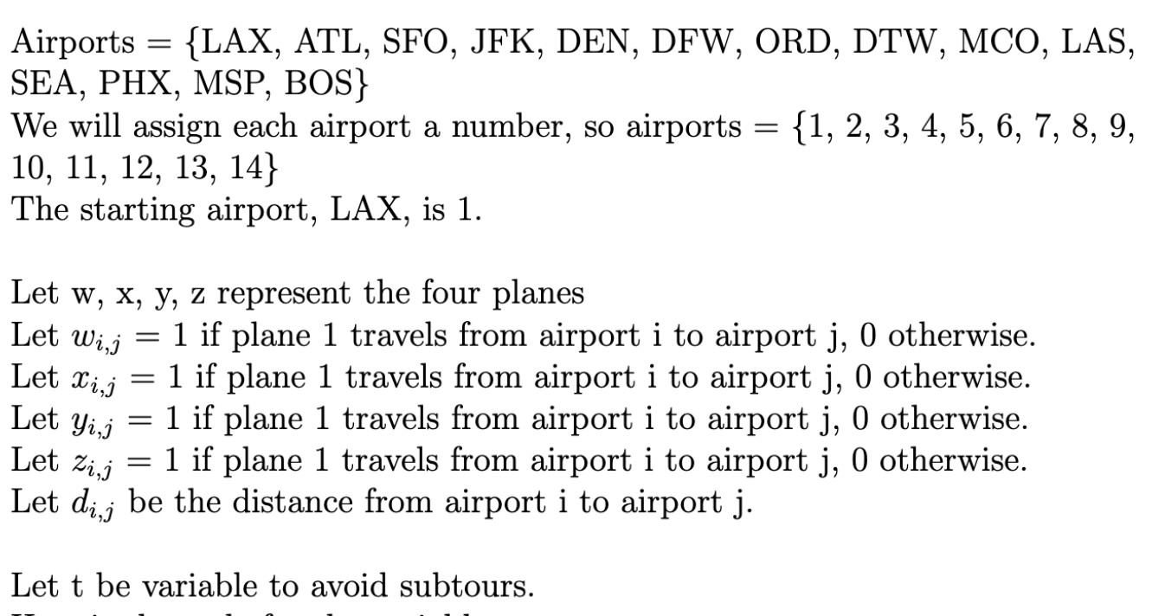
Variables

Slide 6
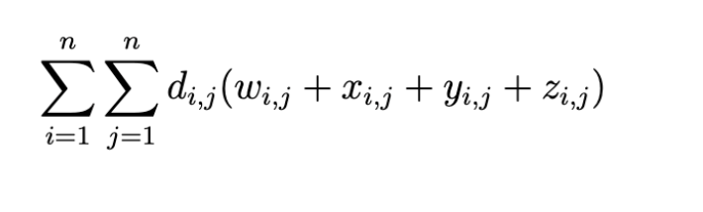
Objective Function

Slide 7
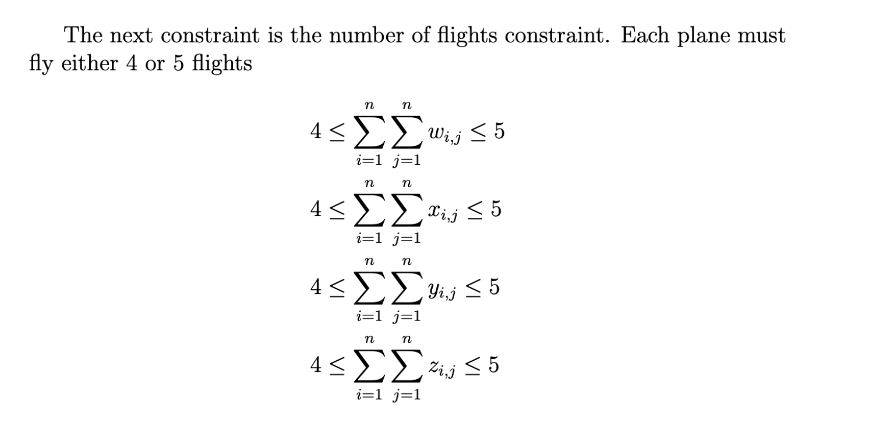
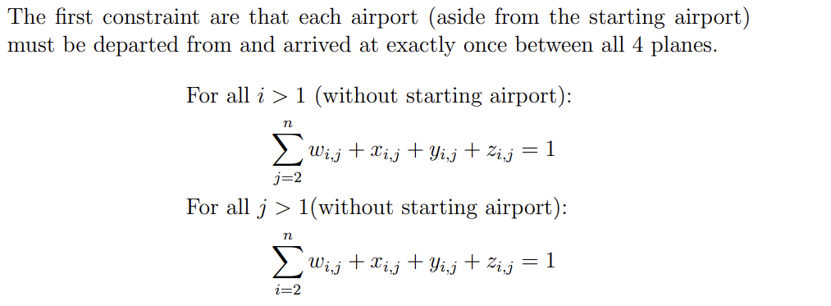
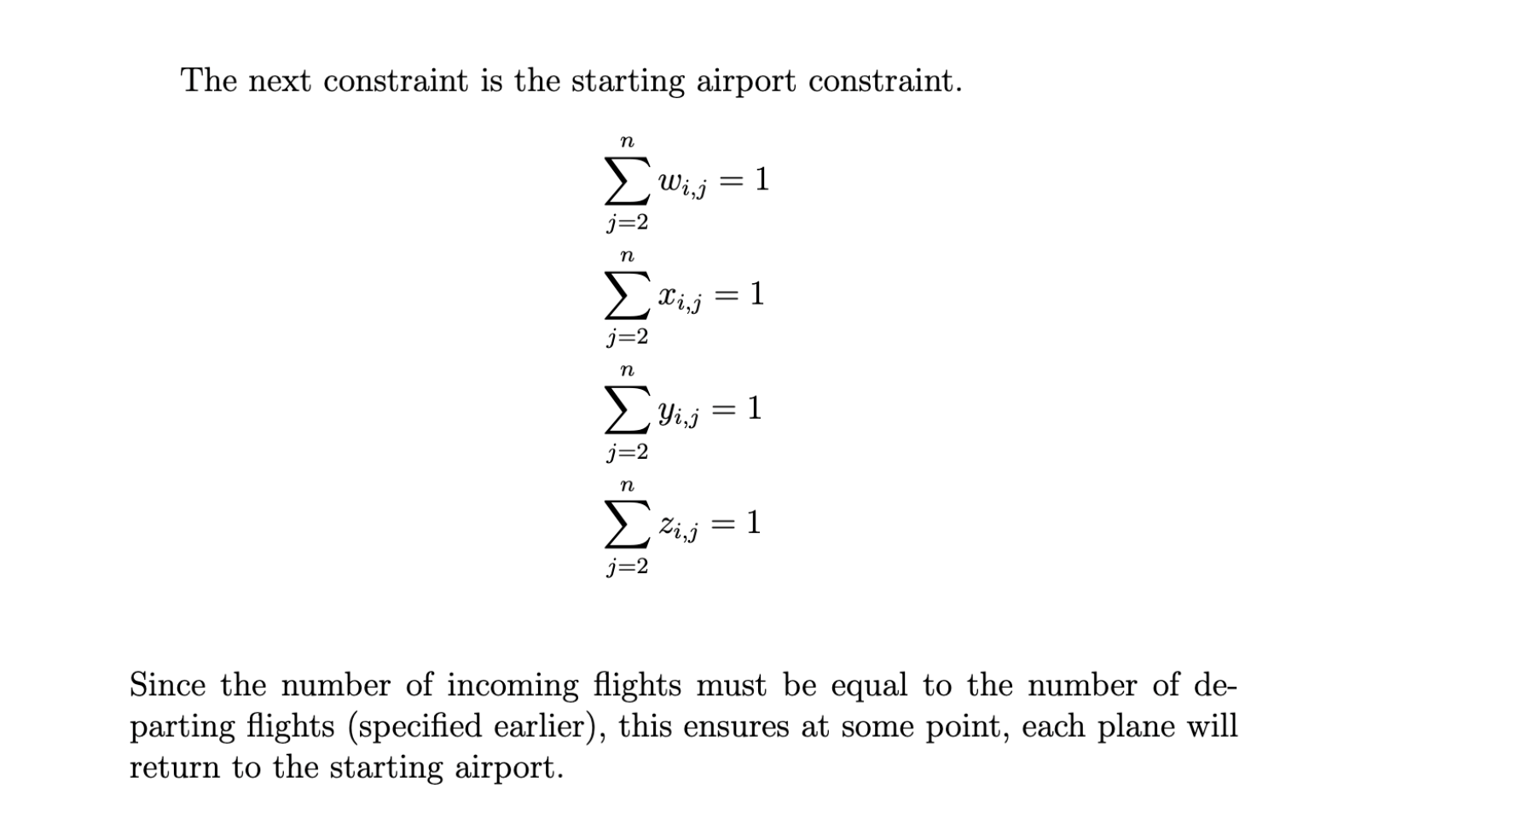
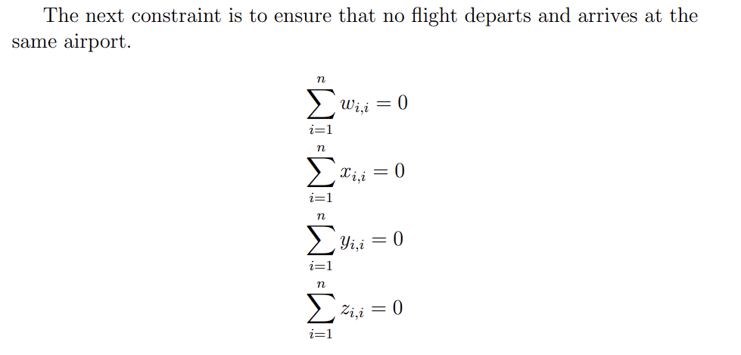
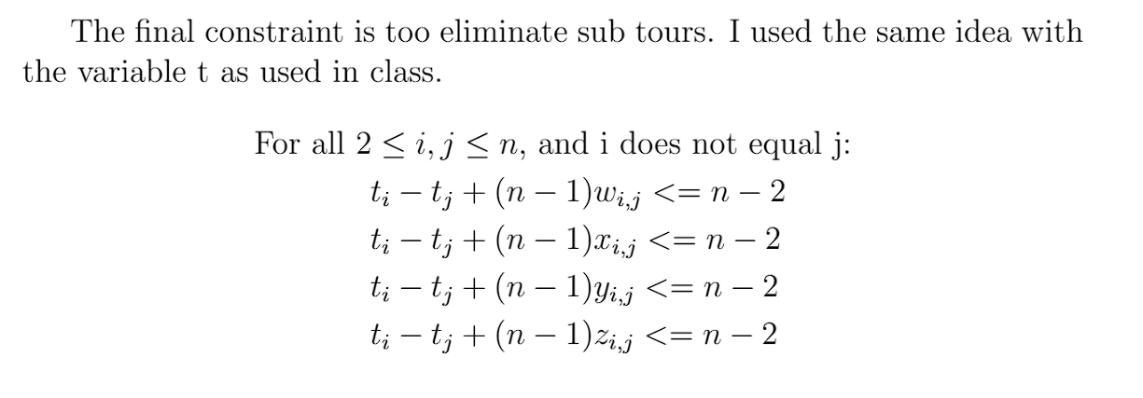
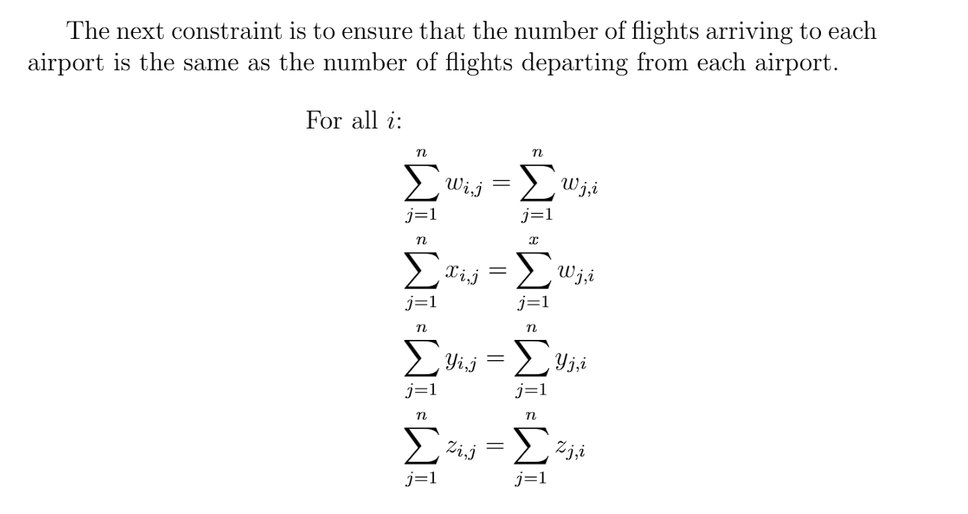
Constraints

Slide 8
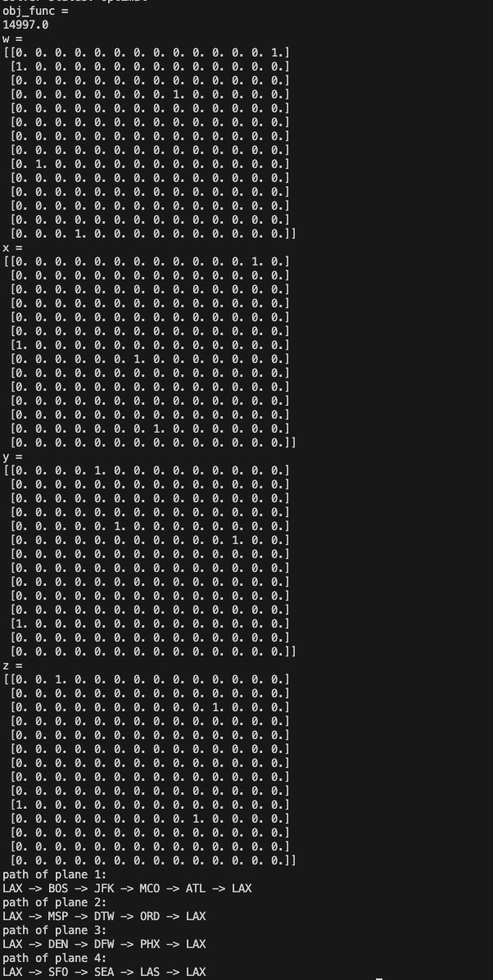
Results
After running the codes for this problem, we get this output:

